Slide 1

Digital Marketing Analyst Project
Elio Bou Serhal

Slide 2
Table of content
2
Introduction
Marketing Campaign & Impressions
Click-Through rate (CTR) , Reach & Frequency
Awareness, Conversion & Consideration
Cost per Acquisition (CPA)
Presentation Title

Slide 3
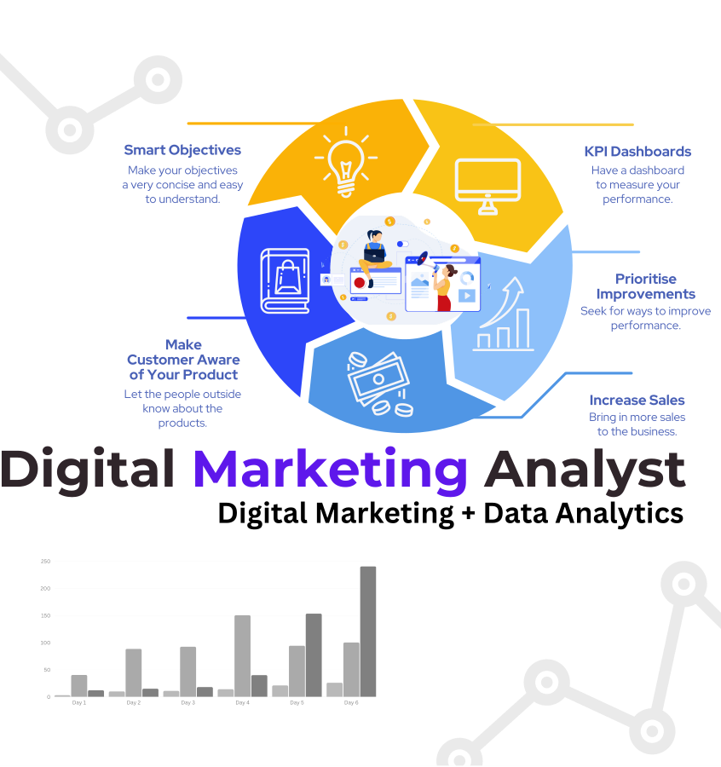
Introduction
3
What is data Analytics in Media?
What is digital Marketing in Media ?
Importance of Data-Driven strategies

Slide 4


1. What is Marketing campaign? 2. What is the significance of Impressions as a media metric? 3. How does it contribute to measuring the effectiveness of a marketing campaign?
4

Slide 5
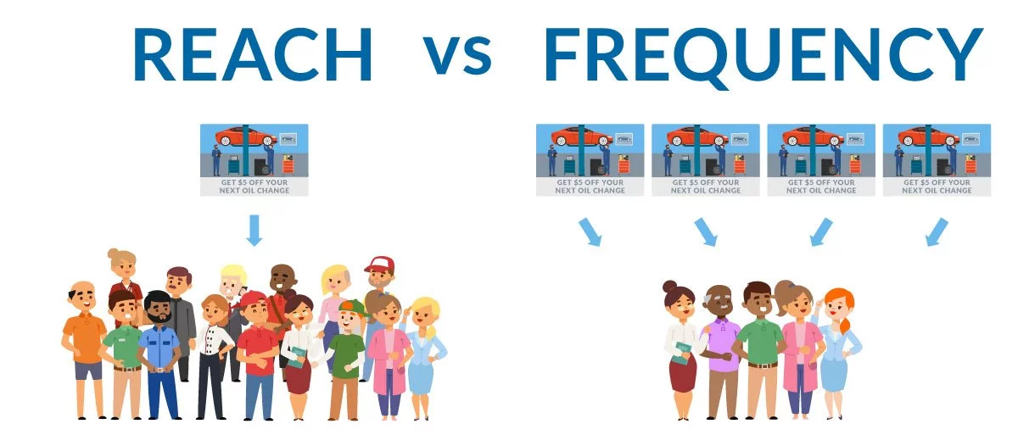
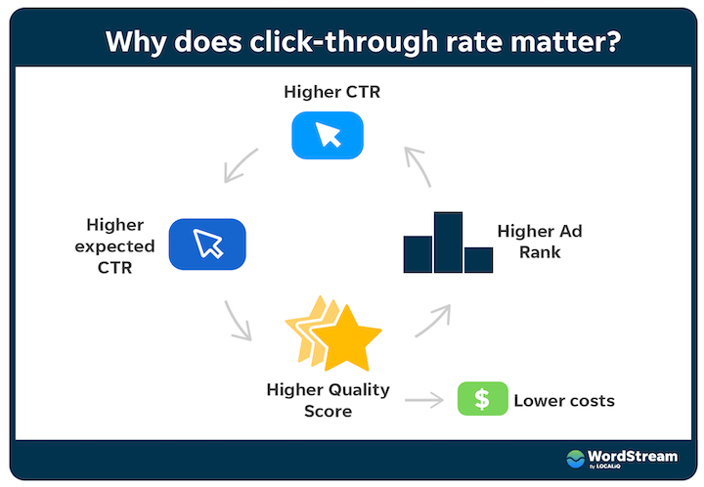
1. What the concept of Click through rate (CTR)? 2. What is the difference between Reach and Frequency ? 3. What role do these metrics play in assessing the impact of a marketing campaign?
5

Slide 6

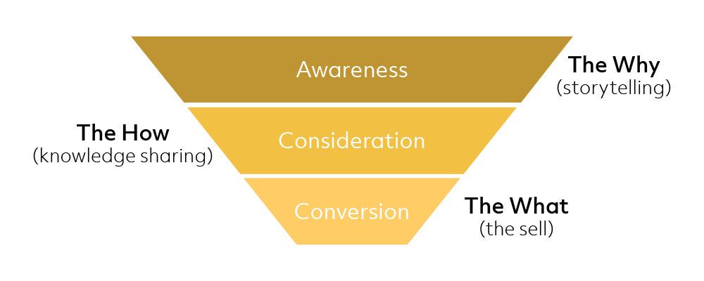
What are the three Marketing phases? 1. Awareness 2. Consideration 3. Conversion
6

Slide 7
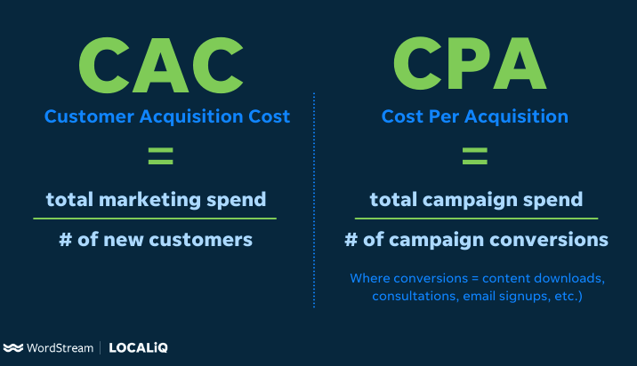
1. What is Customer Acquisition Cost (CAC) ? 2. What is Customer Per Acquisition (CPA) ? 3. How can we evaluating Marketing Channels and Campaigns with CPA and CAC ?
7

Slide 8
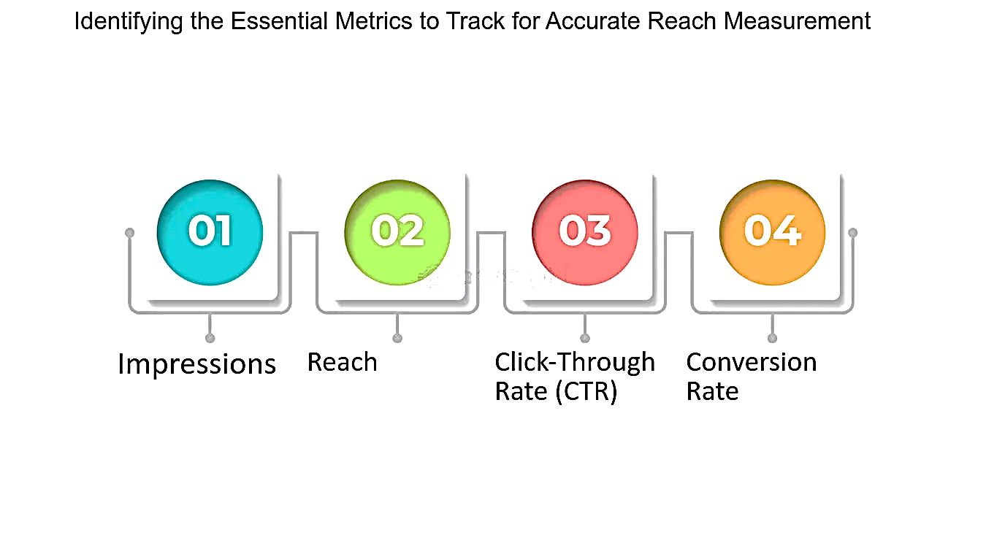

Summary
8
Impressions & Clicks
Click Through rate CTR
Frequency & Reach
Conversion Rate
CPA & CAC
These metrics collectively provide a comprehensive framework for evaluating and optimizing marketing campaign performance

Slide 9

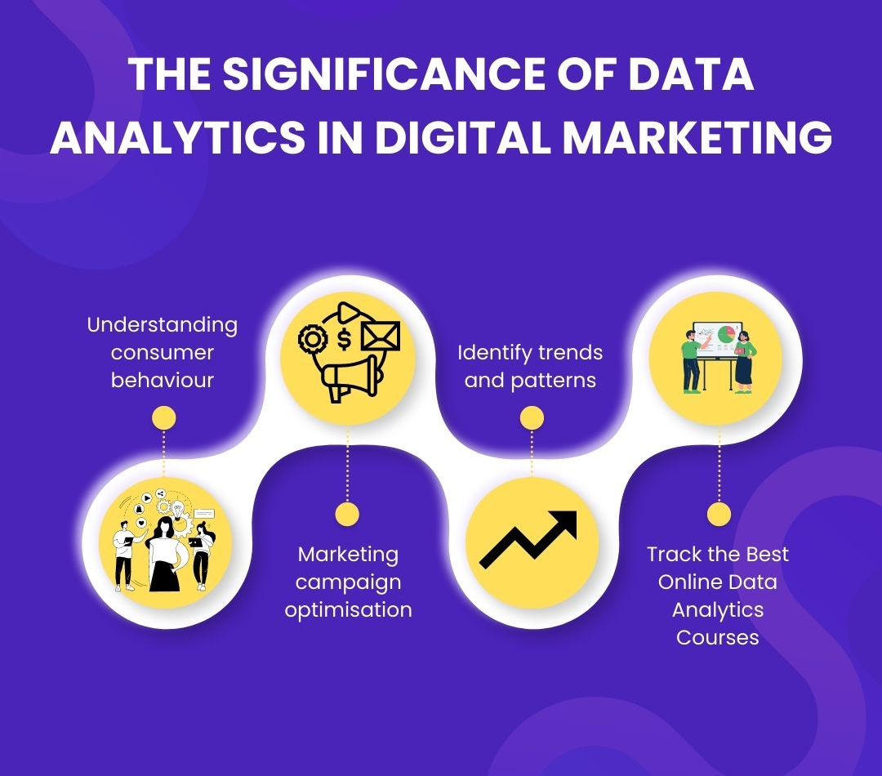


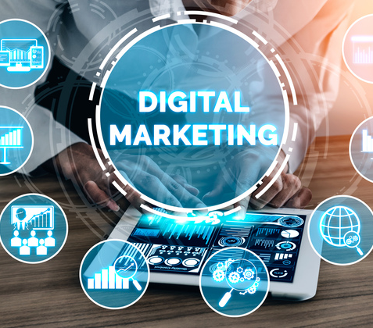
Thank you
9
Elio Bou Serhal
Eliobouserhal.2000@gmail.com
31/07/2024

